Slide 1
LOCAL SEARCH
NHÓM 21
3122410035 - Nguyễn Khải Ca
3122410040 - Đặng Văn Chiến
3120410098 - Đỗ Trịnh Mỹ Duyên

Slide 2
LOCAL SEARCH:
Solving the Traveling Salesman Problem using Local Search
Solving the n-Queens Problem using Local Search

Slide 3
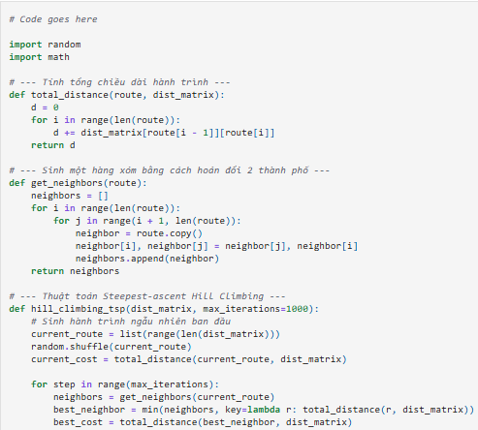
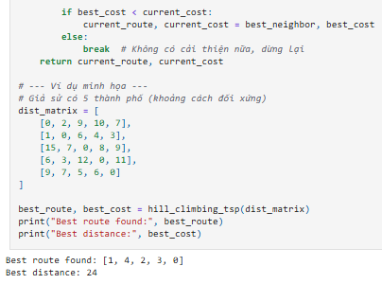
Solving the Traveling Salesman Problem using Local Search Steepest-ascend Hill Climbing Search [3 Points] Calculate the objective function for all local moves (move each queen within its column) and always choose the best among all local moves.

Slide 4
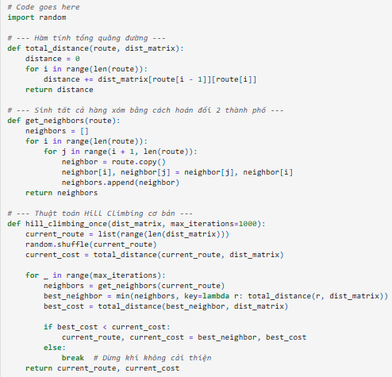
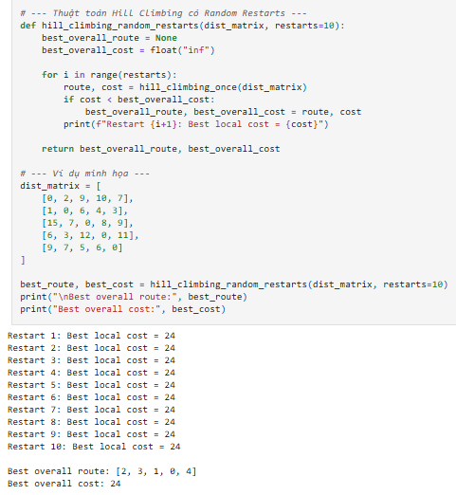
Solving the Traveling Salesman Problem using Local Search Steepest-ascend Hill Climbing Search with Random Restarts [1 Point] Steepest-ascend with random restarts.

Slide 5
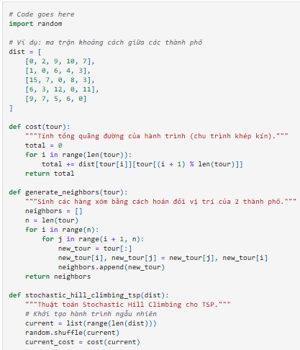
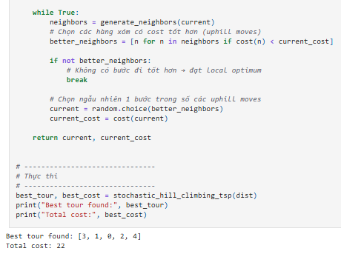
Solving the Traveling Salesman Problem using Local Search Stochastic Hill Climbing [1 Points] Chooses randomly from among all uphill moves.

Slide 6
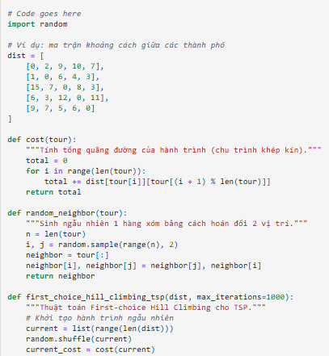
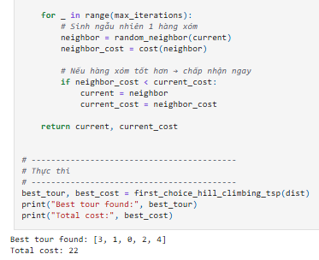
Solving the Traveling Salesman Problem using Local Search First-choice Hill Climbing [1 Point] First-choice hill climbing is a type of stochastic hill climbing that generates one random local neighbor at a time and accept it if it has a better objective function value than the current state.

Slide 7
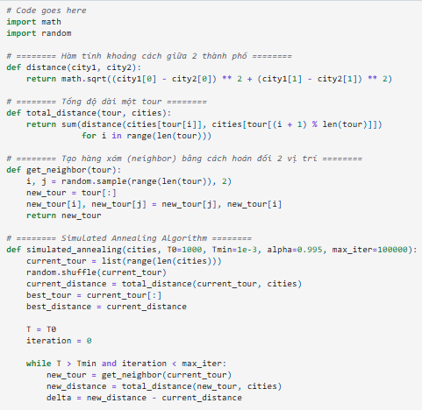
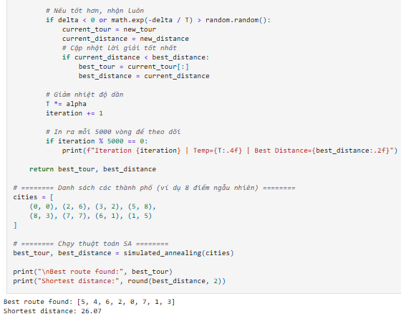
Solving the Traveling Salesman Problem using Local Search Simulated Annealing [2 Points]

Slide 8
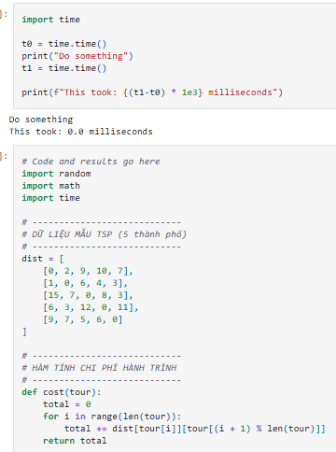
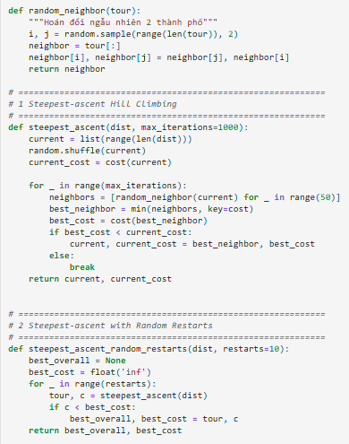
Solving the Traveling Salesman Problem using Local Search Compare Performance [2 Points] Use runtime, scalability (number of cities), and best objective function value to compare the algorithms on boards of different sizes. For timing you can use the time package.

Slide 9
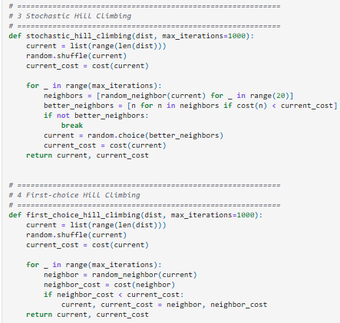
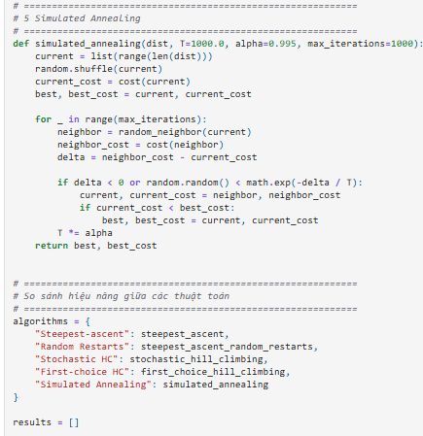
Solving the Traveling Salesman Problem using Local Search Compare Performance [2 Points] Use runtime, scalability (number of cities), and best objective function value to compare the algorithms on boards of different sizes. For timing you can use the time package.

Slide 10
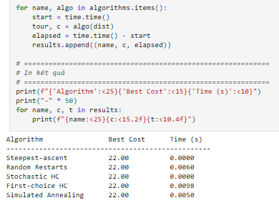
Solving the Traveling Salesman Problem using Local Search Compare Performance [2 Points] Use runtime, scalability (number of cities), and best objective function value to compare the algorithms on boards of different sizes. For timing you can use the time package.

Slide 11
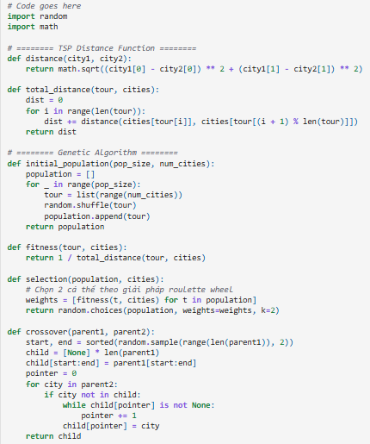
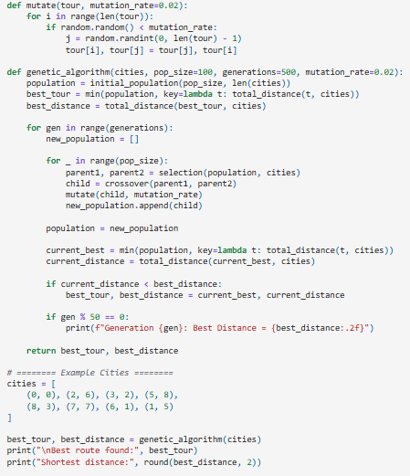
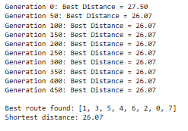
Solving the Traveling Salesman Problem using Local Search Bonus: Genetic Algorithm [+1 Point].

Slide 12
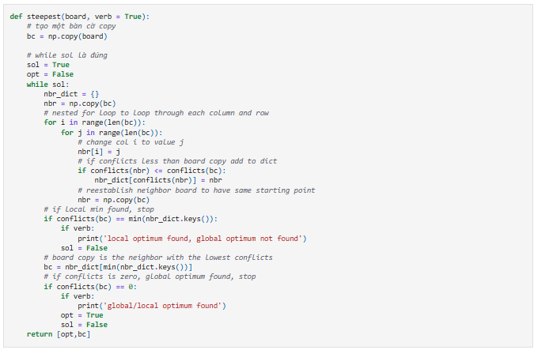
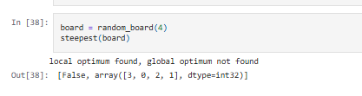
Solving the n-Queens Problem using Local Search Task 1: Steepest-ascend Hill Climbing Search [20 Points] Calculate the objective function for all local moves (see definition of local moves above) and always choose the best among all local moves. If there are no local moves that improve the objective, then you have reached a local optimum.

Slide 13
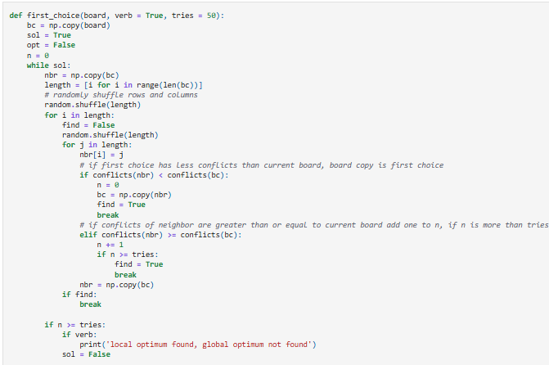
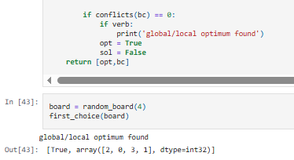
Solving the n-Queens Problem using Local Search Task 3: Stochastic Hill Climbing 2 [20 Points] A popular version of stochastic hill climbing generates only a single random local neighbor at a time and accept it if it has a better objective function value than the current state. This is very efficient if each state has many possible successor states. This method is called "First-choice hill climbing" in the textbook. Notes: Detecting local optima is tricky! You can, for example, stop if you were not able to improve the objective function during the last tries.

Slide 14
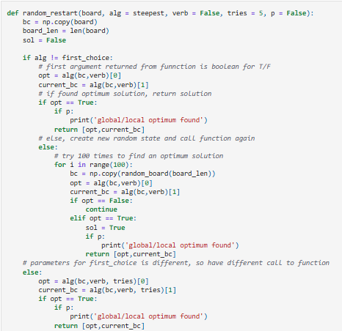
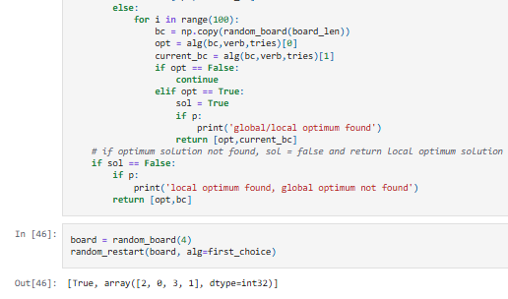
Solving the n-Queens Problem using Local Search Task 4: Hill Climbing Search with Random Restarts [10 Points] Hill climbing will often end up in local optima. Restart the each of the three hill climbing algorithm up to 100 times with a random board to find a better (hopefully optimal) solution. Note that restart just means to run the algorithm several times starting with a new random board.

Slide 15
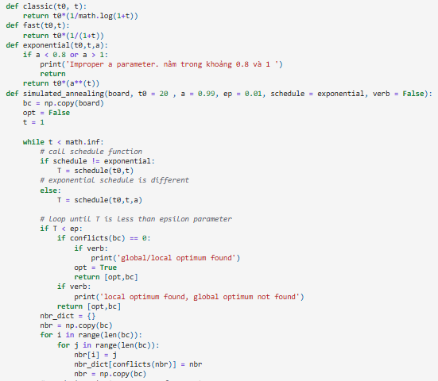
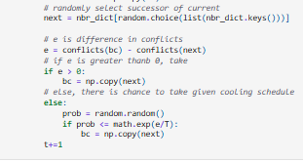
Solving the n-Queens Problem using Local Search Task 5: Simulated Annealing [10 Points] Simulated annealing is a form of stochastic hill climbing that avoid local optima by also allowing downhill moves with a probability proportional to a temperature. The temperature is decreased in every iteration following an annealing schedule. You have to experiment with the annealing schedule (Google to find guidance on this). Implement simulated annealing for the n-Queens problem. Create a visualization of the search process (a line chart of how the number if conflict changes as the algorithm progrsses). Use this visualization for experiments with different choices for the annealing schedule and discuss what you have learned.

Slide 16
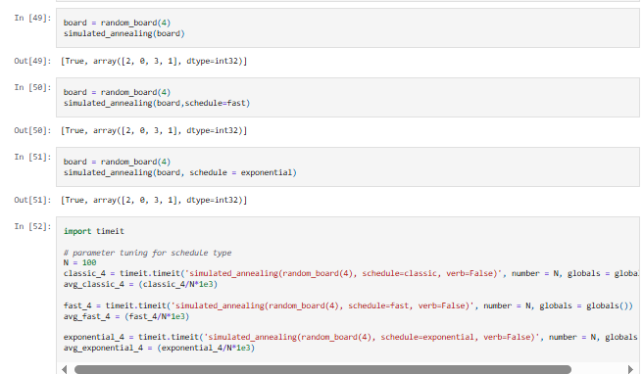
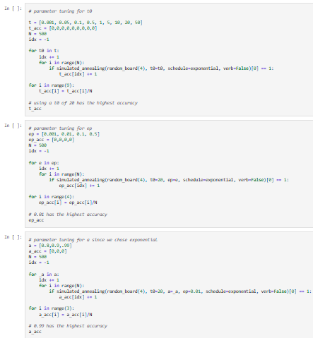
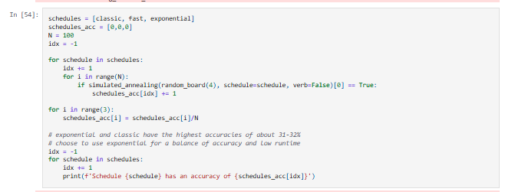
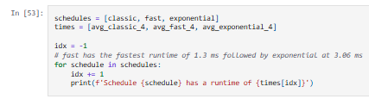
Solving the n-Queens Problem using Local Search Task 5: Simulated Annealing [10 Points] Simulated annealing is a form of stochastic hill climbing that avoid local optima by also allowing downhill moves with a probability proportional to a temperature. The temperature is decreased in every iteration following an annealing schedule. You have to experiment with the annealing schedule (Google to find guidance on this). Implement simulated annealing for the n-Queens problem. Create a visualization of the search process (a line chart of how the number if conflict changes as the algorithm progrsses). Use this visualization for experiments with different choices for the annealing schedule and discuss what you have learned.

Slide 17
Cảm ơn thầy và các bạn đã theo dõi và lắng nghe

